Slide 1
Big Data Technology
Text Analytics
Paul Rad, Ph.D.
Associate Professor
Information Systems and Cyber Security, College of Business School
Electrical and Computer Engineering, College of Engineering

Slide 2
Outline
What is Text
Tokenization
Token normalization
Stemming and Lemmatization
Bag of Words
Vector representation
word embedding
Distance/similarity

Slide 3
Semantic Analysis
X: One morning I shot an elephant in my pajamas
encoding (X)
decode (encoding (X))
X
Y
Communication involves recursive reasoning: how can X choose words to maximize understanding by Y?

Slide 4
What is text?
Construct of text as a sequence of:
Characters
Words
Phrases and names entities
Sentences
Paragraphs

Slide 5
What is a word?
Word
- Meaningful sequence of characters
Text as a sequence of words
Sentence
A set of words that is complete in itself, typically containing a subject and predicate, conveying a statement, question, exclamation, or command.
In English we can split a sentence by spaces or punctuation.
In Japanese there are no spaces at all!

Slide 6

Bag of words (BoW)
Basic method for finding topics in a text
Can be a great way to determine the significant words in a text
The more frequent a word, the more important it might be
We loose word order
Example:
Text: "The cat is in the box. The cat likes the box. The box is over the cat.”
”the": 6, "box": 3, "cat": 3, "is": 2 "in": 1, "likes": 1, "over": 1
Cat, Box, Like,

Slide 7
Tokenization
is a way to split text into tokens. These tokens could be paragraphs, sentences, or individual words.
A token is a useful unit for semantic processing

Slide 8
Token normalization Stemming
We may want the same token for different forms of the word
Laughing, laugh, laughs, laughed→ laugh
In linguistic morphology and information retrieval, stemming is the process for reducing inflected (or sometimes derived) words to their stem, base or root form. A process of removing and replacing suffixes rto get to the root ofmr of the wod, which is called the stem
The most common algorithm for stemming English, and one that has repeatedly been shown to be empirically very effective, is Porter's algorithm (Porter, 1980).
Porter's algorithm consists of 5 phases of word reductions, applied sequentially.
The removal of the inflectional ending from words (strip off any affixes)
Laughing, laugh, laughs, laughed→ laugh
Problems
Can conflate semantically different words
Gallery and gall may both be stemmed to gall

Slide 9
PorterStemmer
cat --> cat
cats --> cat lie --> lie
lying --> lie
run --> run
running --> run
city --> citi
cities --> citi
month --> month
monthly --> monthli
woman --> woman
women --> women

Slide 10
Token normalization - Lemmatization
Usually doing things properly with the use of the vocabulary and morphological analysis. Return to the base or dictionary form of a word, which is known as the lemma

Slide 11
Token Normalization
Word Net Lemmatizer
Uses the WordNet Database to lookup lemmas
nltk.stem.WordNetLemmatizer
Examples:
Feet → Foot
Wolves → Wolf

Slide 12
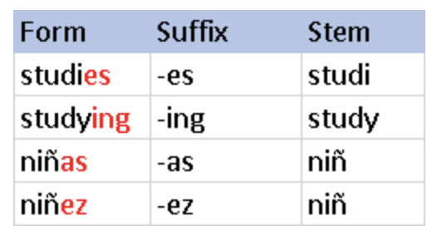
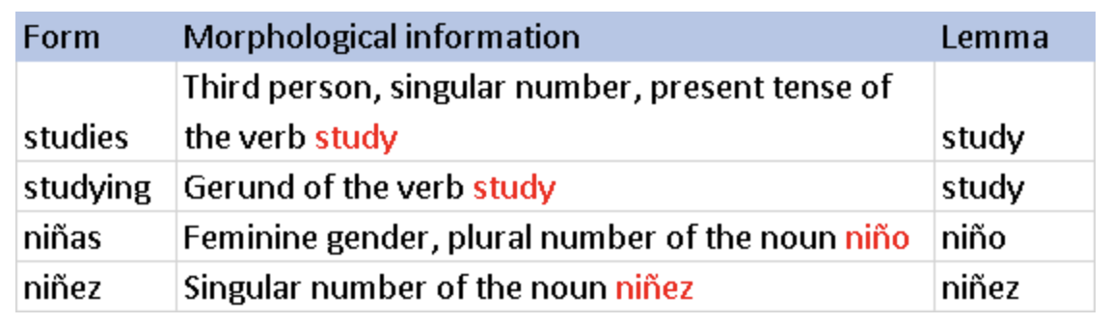
Stemming and Lemmatization
Stemming algorithms work by cutting off the end or the beginning of the word, taking into account a list of common prefixes and suffixes that can be found in an inflected word. This indiscriminate cutting can be successful in some occasions, but not always, and that is why we affirm that this approach presents some limitations. Below we illustrate the method with examples in both English and Spanish.
Lemmatization, on the other hand, takes into consideration the morphological analysis of the words. To do so, it is necessary to have detailed dictionaries which the algorithm can look through to link the form back to its lemma. Again, you can see how it works with the same example words.

Slide 13
Bag of words (BoW)
Basic method for finding topics in a text
Can be a great way to determine the significant words in a text
The more frequent a word, the more important it might be
We loose word order
Example:
Text: "The cat is in the box. The cat likes the box. The box is over the cat.”
”the": 6, "box": 3, "cat": 3, "is": 2 "in": 1, "likes": 1, "over": 1
Cat, Box, Like,

Slide 14

Vector Space Model (VSM)
Represent a document or query by a term vector
Term: basic concepts such as word or n-grams
Each term defines one dimension and N terms (Vocabulary) define an
N-dimensional space or Bag of words (BOW) = (w₁, ...w_{N})
Document vector: d=(y₁, ...y_{N}), y_{i} $∈ ℝ is document term weight$

Slide 15
Vector Space Model (VSM) Assumptions
Terms are assumed to be orthogonal (independent from each other)
Vector Placements base on Vocabularies (w₁, ...w_{N})
Term weight in query and document indicates how well the term characterizes the document or query.
We need to define a similarity function Distance Function (d1, d2) for measuring the relevance.

Slide 16
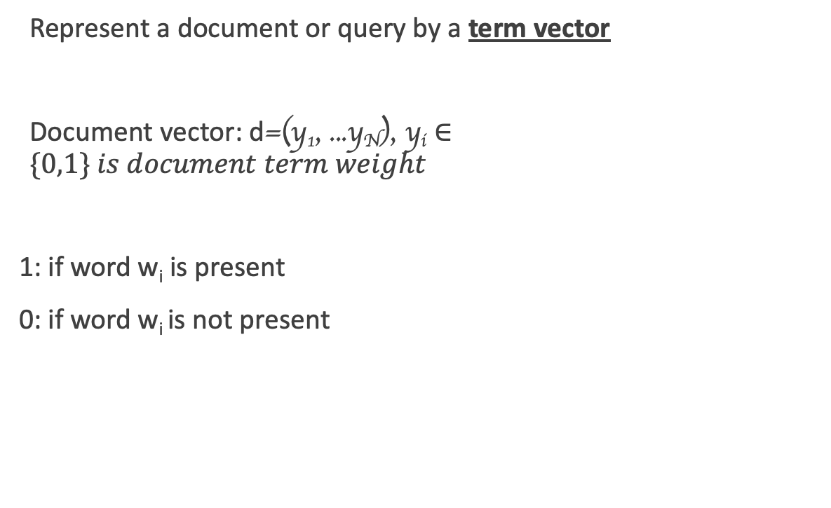
Bit Vector Presentation
Represent a document or query by a term vector
Document vector: d=(y₁, ...y_{N}), y_{i} $∈\{0,1\} is document term weight$
1: if word w_{i} is present
0: if word w_{i} is not present
w3
N-dimensional space,
Dictionary = (w₁, ...w_{N})
w2
w1

Slide 17
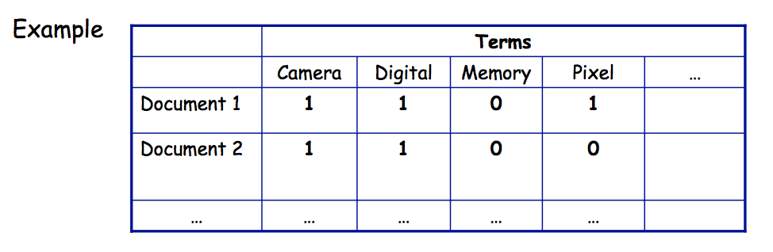
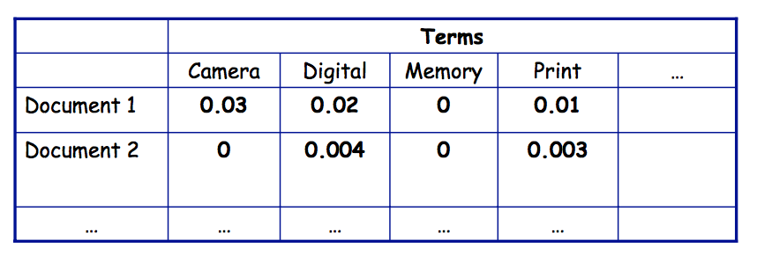
Bag of words - Text Vectorization
One possible approach:
Each entry describes a document
Attribute describe whether or not a term appears in the in the document Example: Term frequency table document
Another approach (Term Frequency):
Attributes represent the frequency in which a term appears in the document

Slide 18

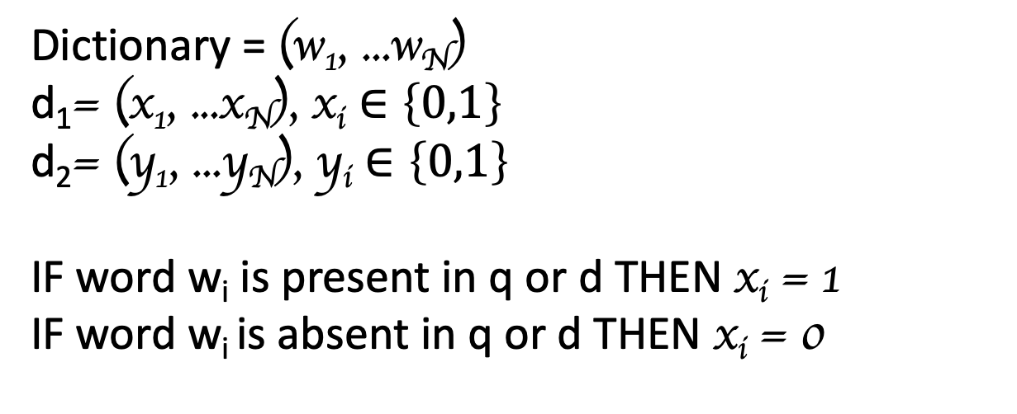
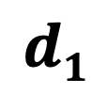
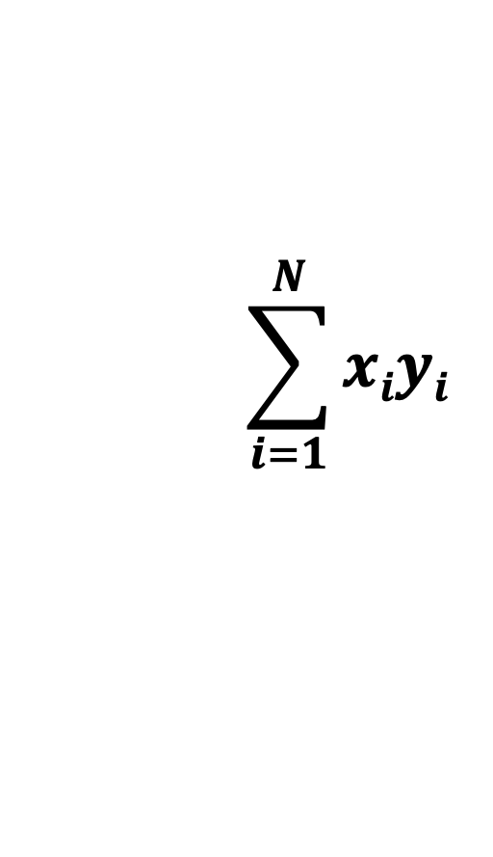

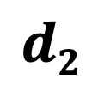
Similarity → Distance Function: DoT Product
Dictionary = (w₁, ...w_{N})
d₁= (x₁, ...x_{N}), x_{i} $∈\left\{0,1\right\}$
d₂= (y₁, ...y_{N}), y_{i} $∈\left\{0,1\right\}$
IF word w_{i} is present in q or d THEN x_{i} = 1
IF word w_{i} is absent in q or d THEN x_{i} = 0
$$\sum_{i=1}^{N}{xiyi}$$
$$→$$
$$→$$
.
D (d₁, d₂) =
$$d1$$
$$d2$$
= x₁y₁ + x₂y₂ + …. x_{n}y_{n} =

Slide 19
How to represent a word (word embedding)
Google Book https://code.google.com/archive/p/word2vec
100 billion tokens, 300 dimension, 3M words
Glove project http://nlp.stanford.edu/projects/glove/
Pre-trained word vectors of Wiki (6B), web crawl data (840B), twitter (27B)

Slide 20
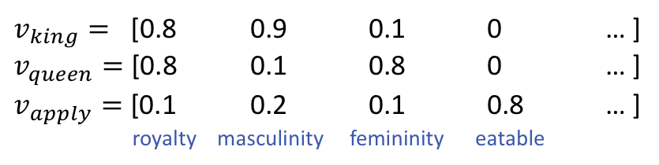

Vector representation
Discrete $⇒$ distributed representations
Word meanings are vector of “basic concept”
What are “basic concept”?
How to assign weights?
How to define the similarity/distance?
$v_{king}=$ [0.8 0.9 0.1 0 … ]
$v_{queen}=$ [0.8 0.1 0.8 0 … ]
$v_{apply}=$ [0.1 0.2 0.1 0.8 … ]
royalty masculinity femininity eatable

Slide 21
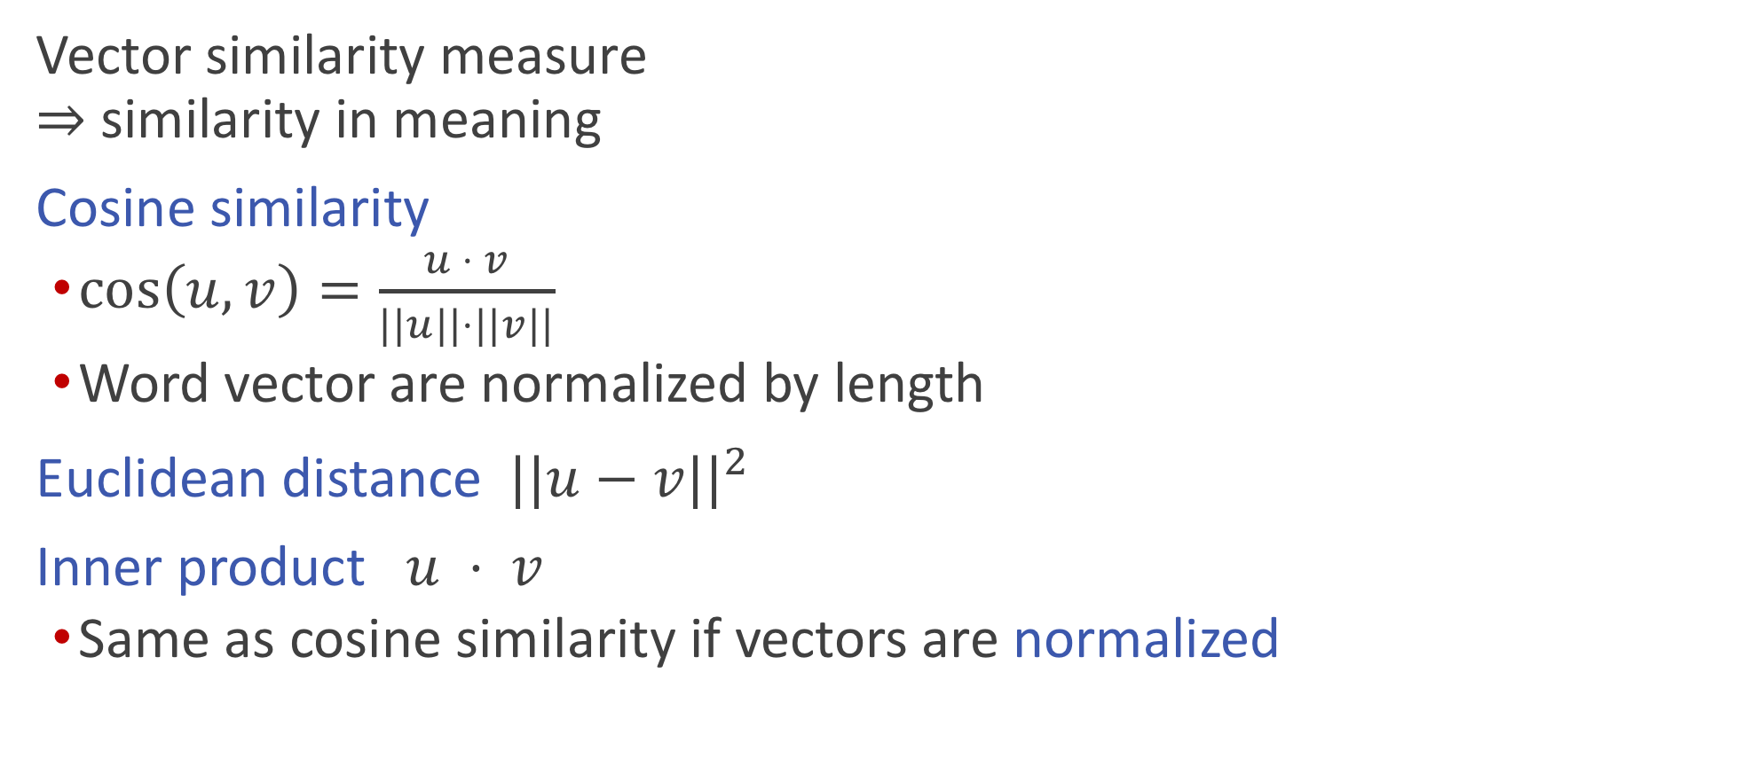
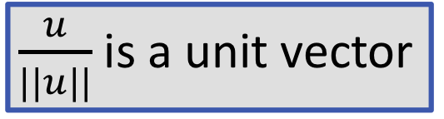
Distance/similarity
Vector similarity measure $⇒$ similarity in meaning
Cosine similarity
$\cos\left(u,v\right)=\frac{u ⋅ v}{||u||⋅||v||}$
Word vector are normalized by length
Euclidean distance $||u−v||^{2}$
Inner product $u ⋅ v$
Same as cosine similarity if vectors are normalized
$\frac{u}{||u||}$ is a unit vector

Slide 22
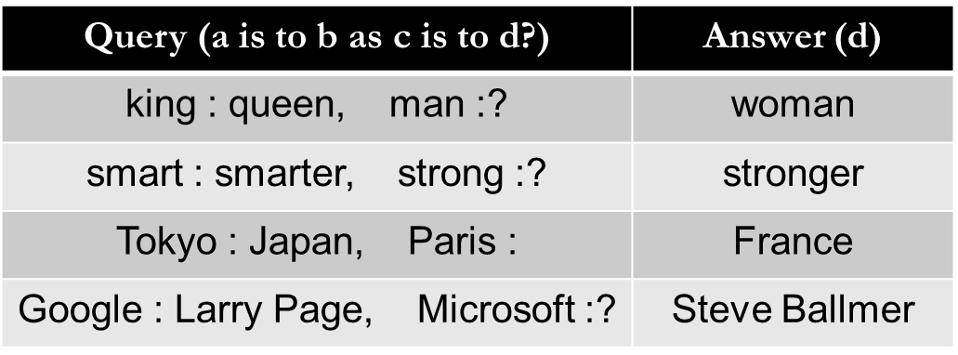
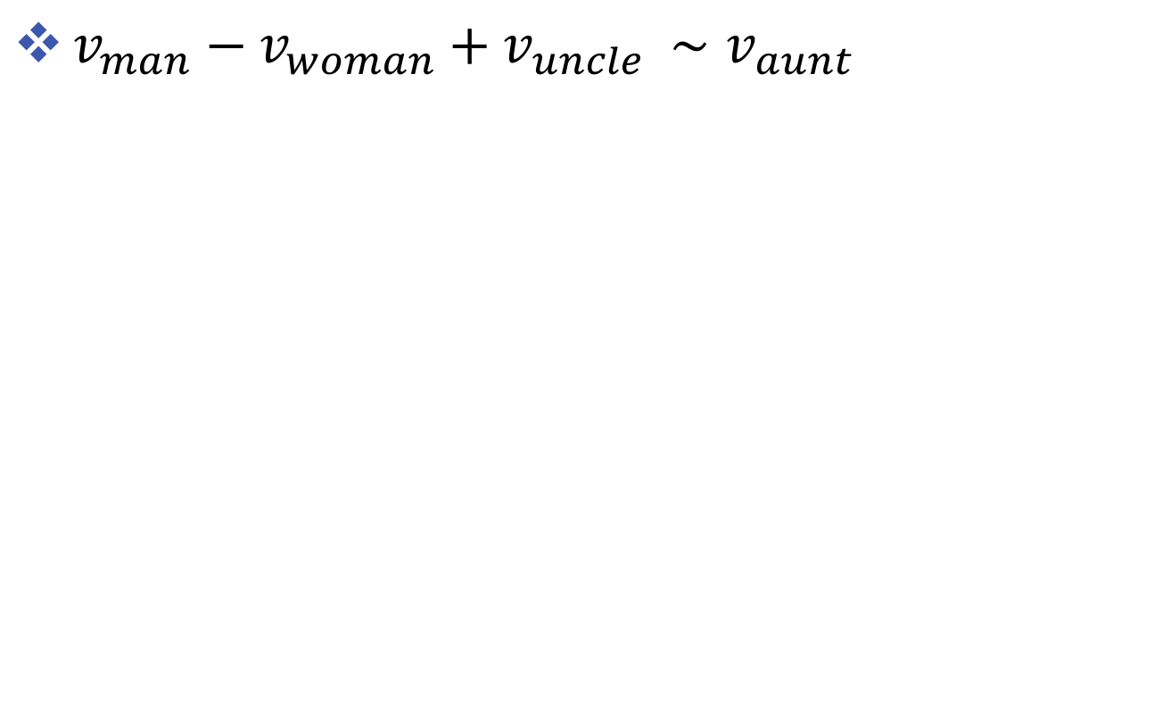
Word analogy
$v_{man}−v_{woman}+v_{uncle }{∼v}_{aunt }$

Slide 23
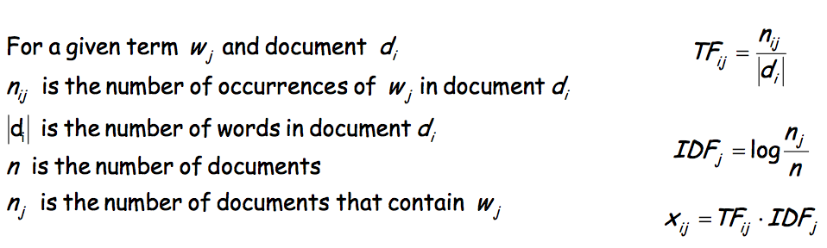
Term Frequencies
TF-IDF weighting: give higher weight to terms that are rare
TF: term frequency (increases weight of frequent terms)
If a term is frequent in lots of documents it does not have discriminative power
IDF: inverse term frequency

Slide 24
Semantic Analysis
X: One morning I shot an elephant in my pajamas
encoding (X)
decode (encoding (X))
X
Y
Communication involves recursive reasoning: how can X choose words to maximize understanding by Y?

Slide 25
What is text?
Construct of text as a sequence of:
Characters
Words
Phrases and names entities
Sentences
Paragraphs

Slide 26
What is a word?
Word
- Meaningful sequence of characters
Text as a sequence of words
Sentence
A set of words that is complete in itself, typically containing a subject and predicate, conveying a statement, question, exclamation, or command.
In English we can split a sentence by spaces or punctuation.
In Japanese there are no spaces at all!

Slide 27
Tokenization
is a way to split text into tokens. These tokens could be paragraphs, sentences, or individual words.
A token is a useful unit for semantic processing

Slide 28
Token normalization
Stemming In linguistic morphology and information retrieval, stemming is the process for reducing inflected (or sometimes derived) words to their stem, base or root form.
The most common algorithm for stemming English, and one that has repeatedly been shown to be empirically very effective, is Porter's algorithm (Porter, 1980).
Porter's algorithm consists of 5 phases of word reductions, applied sequentially.
The removal of the inflectional ending from words (strip off any affixes)
Laughing, laugh, laughs, laughed→ laugh
Problems
Can conflate semantically different words
Gallery and gall may both be stemmed to gall

Slide 29
PorterStemmer
cat --> cat
cats --> cat lie --> lie
lying --> lie
run --> run
running --> run
city --> citi
cities --> citi
month --> month
monthly --> monthli
woman --> woman
women --> women

Slide 30
Token Normalization
Word Net Lemmatizer
Uses the WordNet Database to lookup lemmas
nltk.stem.WordNetLemmatizer
Examples:
Feet → Foot
Wolves → Wolf
Cats → Cat

Slide 31
Stemming and Lemmatization
Stemming algorithms work by cutting off the end or the beginning of the word, taking into account a list of common prefixes and suffixes that can be found in an inflected word. This indiscriminate cutting can be successful in some occasions, but not always, and that is why we affirm that this approach presents some limitations. Below we illustrate the method with examples in both English and Spanish.
Lemmatization, on the other hand, takes into consideration the morphological analysis of the words. To do so, it is necessary to have detailed dictionaries which the algorithm can look through to link the form back to its lemma. Again, you can see how it works with the same example words.

Slide 32
Bag of words (BoW)
Basic method for finding topics in a text
Can be a great way to determine the significant words in a text
The more frequent a word, the more important it might be
We loose word order
Example:
Text: "The cat is in the box. The cat likes the box.
The box is over the cat.”
”the": 6, "box": 3, "cat": 3, "is": 2 "in": 1, "likes": 1, "over": 1
Cat, Box, Like,

Slide 33
Bag of words - Text Vectorization
One possible approach:
Each entry describes a document
Attribute describe whether or not a term appears in the in the document Example: Term frequency table document
Another approach:
Attributes represent the frequency in which a term appears in the document

Slide 34
How to represent a word (word embedding)
Google Book https://code.google.com/archive/p/word2vec
100 billion tokens, 300 dimension, 3M words
Glove project http://nlp.stanford.edu/projects/glove/
Pre-trained word vectors of Wiki (6B), web crawl data (840B), twitter (27B)

Slide 35
Vector representation
Discrete $⇒$ distributed representations
Word meanings are vector of “basic concept”
What are “basic concept”?
How to assign weights?
How to define the similarity/distance?
$v_{king}=$ [0.8 0.9 0.1 0 … ]
$v_{queen}=$ [0.8 0.1 0.8 0 … ]
$v_{apply}=$ [0.1 0.2 0.1 0.8 … ]
royalty masculinity femininity eatable

Slide 36
Distance/similarity
Vector similarity measure $⇒$ similarity in meaning
Cosine similarity
$\cos\left(u,v\right)=\frac{u ⋅ v}{||u||⋅||v||}$
Word vector are normalized by length
Euclidean distance $||u−v||^{2}$
Inner product $u ⋅ v$
Same as cosine similarity if vectors are normalized
$\frac{u}{||u||}$ is a unit vector

Slide 37
Word analogy
$v_{man}−v_{woman}+v_{uncle }{∼v}_{aunt }$

Slide 38
Term Frequencies
TF-IDF weighting: give higher weight to terms that are rare
TF: term frequency (increases weight of frequent terms)
- If a term is frequent in lots of documents it does not have discriminative power
IDF: inverse term frequency

